Slide 1

Welcome to Year 5
Teacher: Mrs Kerry Jones (Mrs J)
Mrs W. Abbs (Monday)
Teaching Assistant: Mrs J. Falcon-Uff

Slide 2
A bit about us…
Mrs Jones
Mrs Falcon-Uff - Teaching Assistant

Slide 3
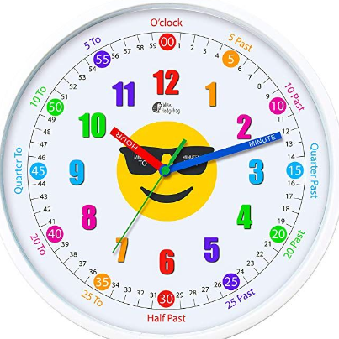

Routines
8:35am Coming into school is a trickle entry, children can come in from 8:35am and the doors close at 8:45am. The earlier the better as we complete early morning reading and learning during this time!
Water Sports top bottles please. Water bottles are kept in the water bottle area. The children have access to this throughout the day.
Book Bags Reading Record and Pupil Planners must be brought in every morning and taken home every evening.
Wellingtons Please could all children have a named pair of wellingtons to store at school as we plan to use the school field as much as possible.
All home reading must be logged in the Reading Record daily.
It can be a book of their choice or their school reading book.

Slide 4


Curriculum Autumn Term 1
ENGLISH
Our Reading and Writing texts for Term 1.

Slide 5
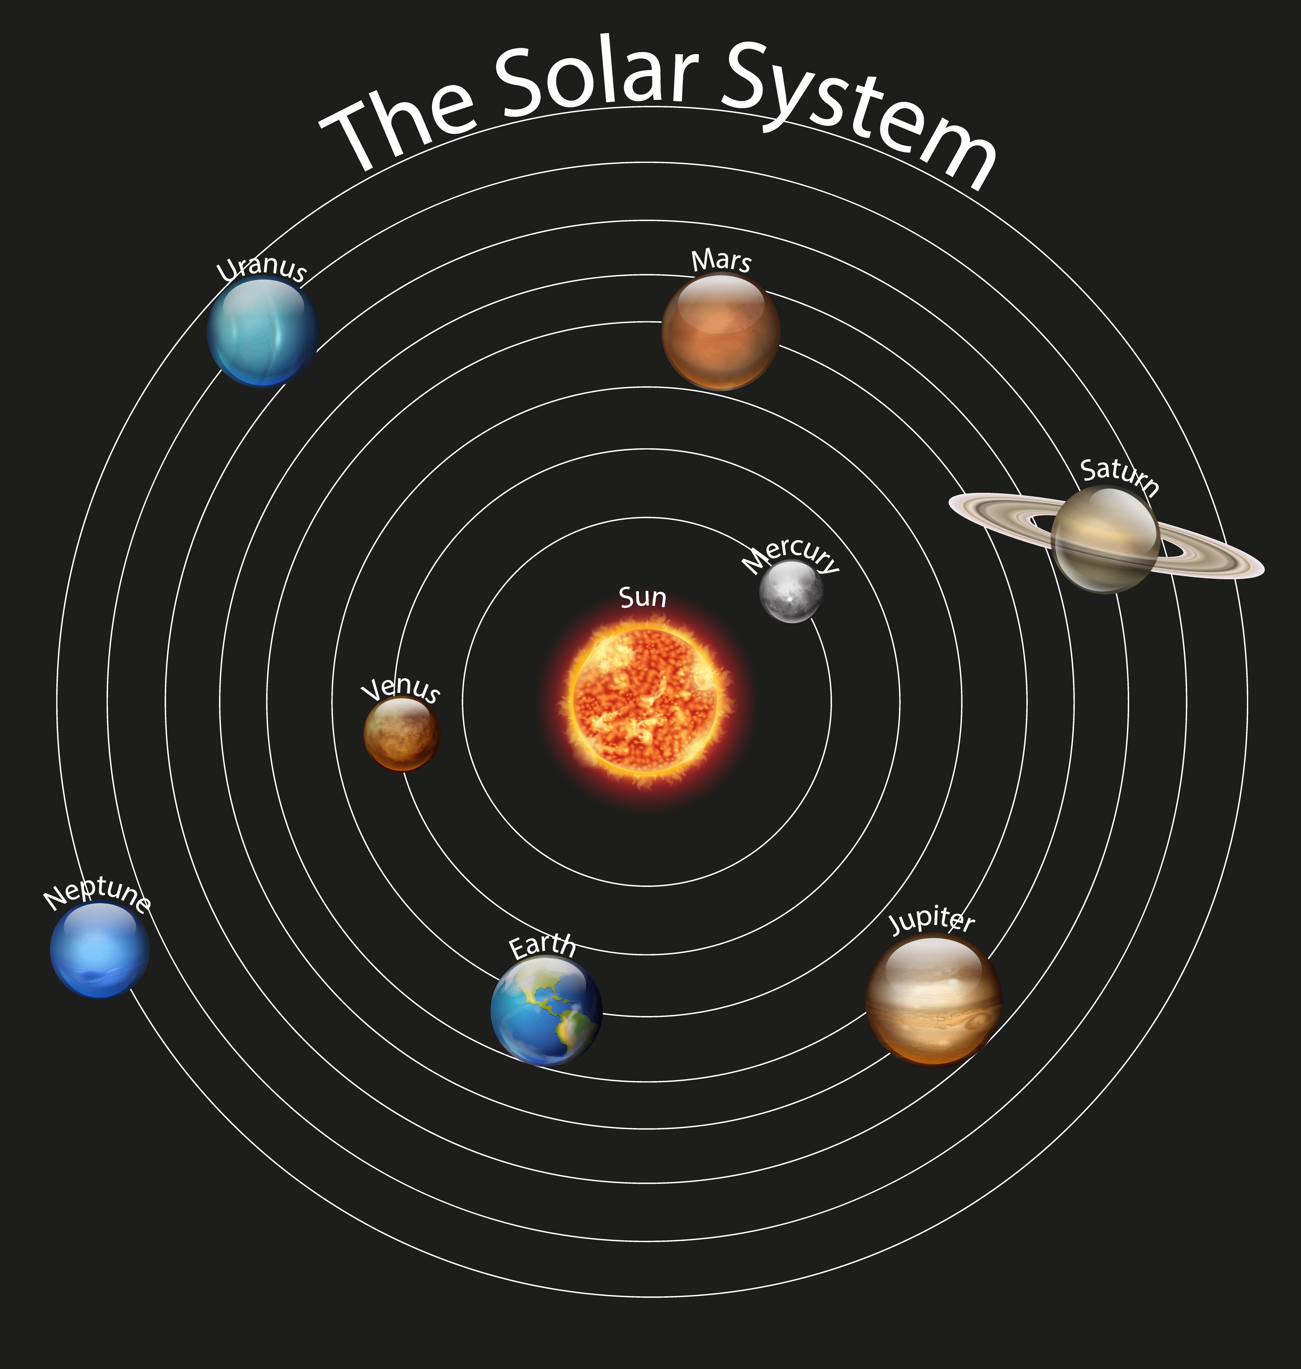
Curriculum Autumn Term 1
MATHS
Place value and addition and subtraction.
SCIENCE
The children will explore the Earth, Moon, Sun and solar system. They will use the idea of the Earth’s rotation to explain day and night and the apparent movement of the sun across the sky. Describe the movement of the Moon, relative to the Earth, and describe the Sun, Earth and Moon as approximately spherical bodies.
GEOGRAPHY
During the term, the children will explore the Alps as a major European mountain range, investigating their location, physical features and how they were formed. They will learn about the climate, wildlife and natural landscapes of the region, as well as how altitude affects the environment. Pupils examine how people live and work in the Alps, including farming, tourism and transport, and compare alpine life with life in the UK. They also consider the opportunities and challenges of living in a mountainous environment and investigate how tourism and climate change affect the Alps. Throughout the unit, children develop their geographical knowledge through map work, data analysis, fieldwork-style enquiries and comparisons between different places.

Slide 6
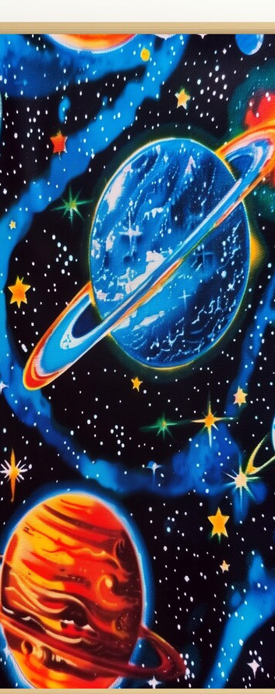
Curriculum Autumn Term 1
ART
Throughout our Art lessons this term the children will work towards producing a retro-futurism inspired mixed media piece of a view in Space.
COMPUTING
In this unit, pupils will explore how data is collected, stored and analysed using the context of a Mars rover mission. They learn how computers gather and organise information using spreadsheets and databases, before presenting data in charts and graphs. Children investigate patterns, draw conclusions from real-world data and consider how technology supports scientific exploration of space. The unit develops data handling, computational thinking and digital literacy skills while encouraging problem-solving and logical reasoning.
MUSIC
The children will be learning to play the recorder, whilst learning to read and write some notes.
The children will learn how to hold the recorder and form the correct lip shape (embouchure) to help them to make a good, consistent sound. They will also start to explore how to control breathing and tonguing to sound notes.

Slide 7
Curriculum Autumn Term 1
RE
During this term, pupils will explore why people of different religions and worldviews choose to stand up for their beliefs and values. They investigate inspirational individuals, religious teachings and real-life examples of courage, justice and compassion. Children consider how beliefs influence actions and reflect on how they can make positive choices in their own lives.
PSHE
Pupils learn how to care for their physical and mental wellbeing as they grow and change. They explore healthy lifestyles, emotional wellbeing, and strategies for managing feelings and making safe, responsible choices. Children develop the knowledge and confidence to support their health, relationships and personal development.
FRENCH
Throughout the term pupils will learn and use French vocabulary related to space, planets, and space exploration. They develop their speaking, listening, reading and writing skills by describing space-themed objects and events using simple sentences.

Slide 8

Homework
Times Table Rock Stars.
Daily reading.
Homework will include spelling words to learn and write into full sentences, an arithmetic or maths activity on White Rose Infinity and a short reading comprehension or a grammar activity.
Homework will be linked to learning during the week, either as pre-learning or post-learning.
Homework and Spellings are set on a Friday and expected in on the following Thursday.
Homework Club runs on a Tuesday lunchtime 12-12:30pm. All children are welcome to attend.
Weekly spellings test will be on a Friday morning.
Reading at home is SO important – even 10 mins a night would make a difference!
If a device is not available at home to complete the maths homework, please do let me know and a paper copy can be printed.
Readers / Helpers are always very welcome.

Slide 9


Slide 10
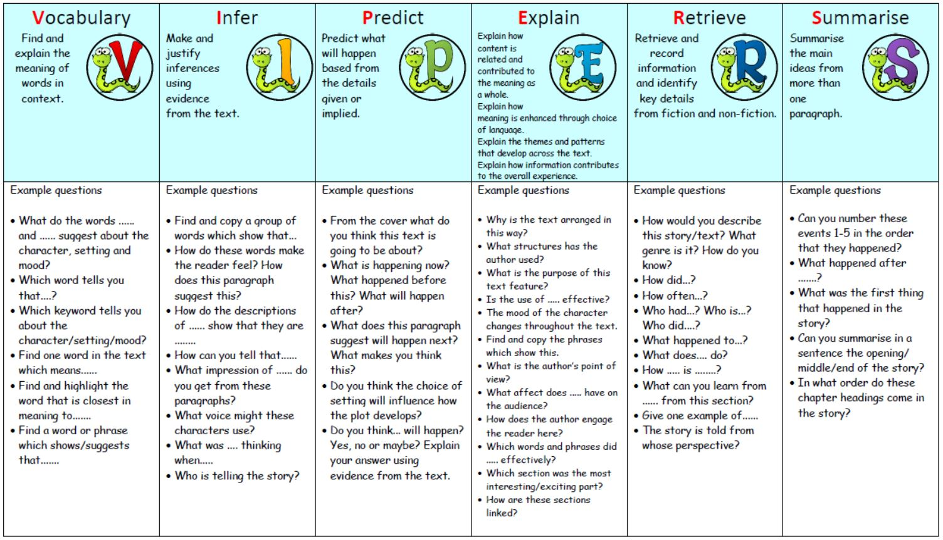

Slide 11

Extra Info...!
PE is on a Tuesday and Wednesday afternoon.
Children may come to school in their PE kits.
  Earrings need to be removed or covered with tape if they have just been pierced.
  Watches should be removed.
  Long hair should be tied up.

Slide 12
Trips and Events
Term 1 Village Enquiry for Geography & author visit
Term 2 Knole House Tudor workshops & card party
Term 3 World Book Week
Term 4 Viking Activity
Term 5 Hastings Trip for Geography- Why do Oceans Matter?
Term 6 Creative Week & Greek Day
We will also be visiting the local community groups and library.

Slide 13
Finally…
All children should feel safe and happy at school so if you have any concerns, we are always happy to help.
Our mornings are usually spent preparing for the day ahead so please speak to us at the end of a school day if possible.
Please email me directly on class5@kemsing.kent.sch.uk
To arrange an appointment, please email me directly on Class 5 or put a note in the Pupil Planner. We have an open-door policy, so please do not hesitate to get in touch with us if we can be of any help.

Slide 14
Thank you for your time and for coming to meet us!
Any questions?

