Slide 1

Galaxy
Year 6 Residential Trip
Friday 15th – Monday 18th May 2026

Slide 2
Aims of a Year 6 residential.
A residential isn’t just a break from school – it’s an extension of it.
Each activity helps pupils build real-world skills that complement classroom learning, develop character and strengthen relationships.
Children learn to take on challenges, work as a team and discover what they’re capable of – building confidence that carries back into everyday school life.

Slide 3
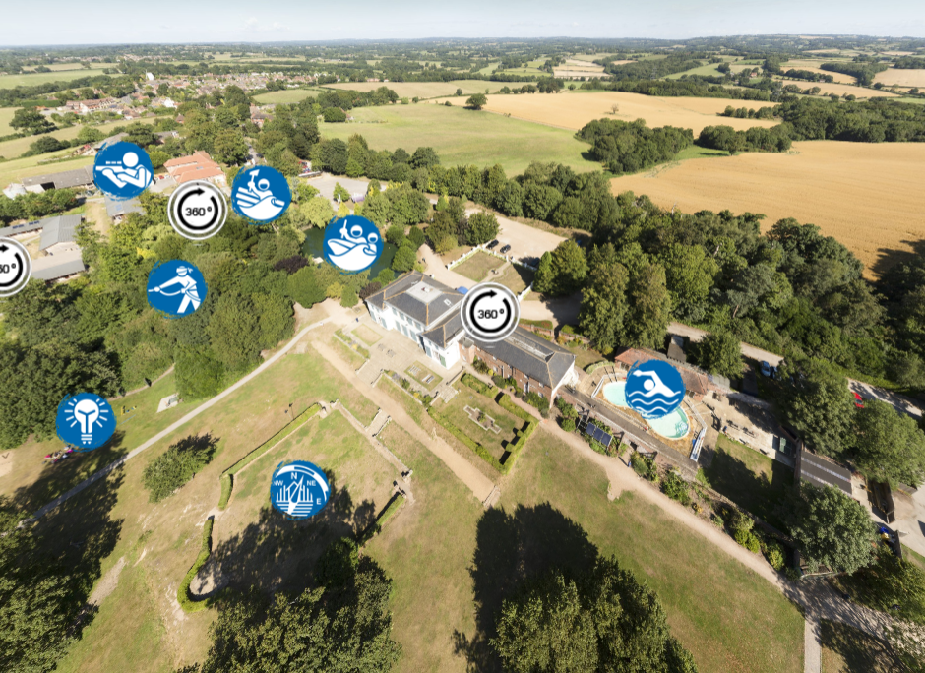
PGL at Windmill Hill
The whole site is securely fenced around its perimeter and accessed through a phone-operated electric gate.

Slide 4
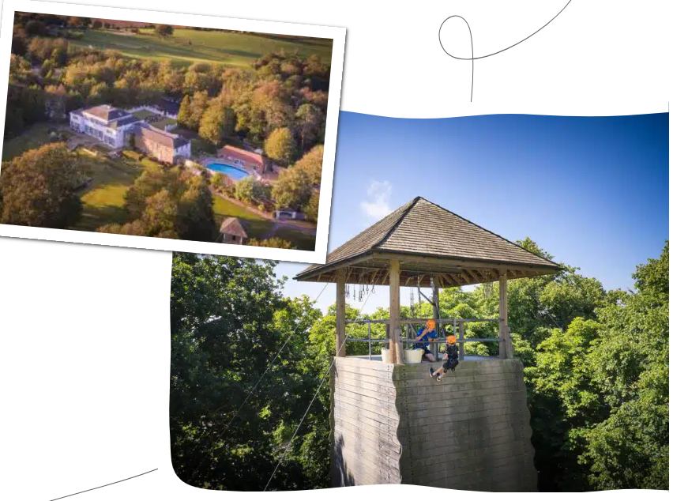
Introduction
Plenty of challenging activities to fill the whole four days!

Slide 5
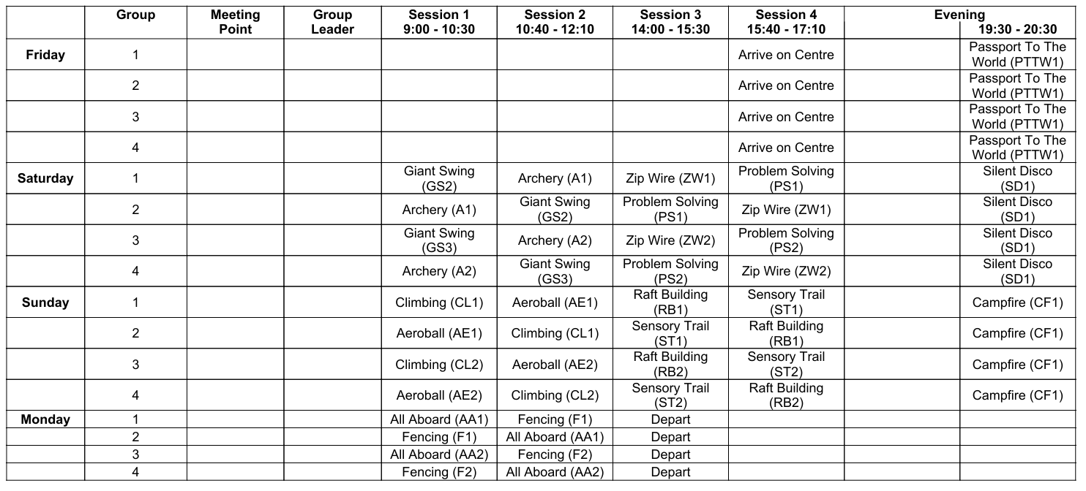
Itinerary for the trip.

Slide 6
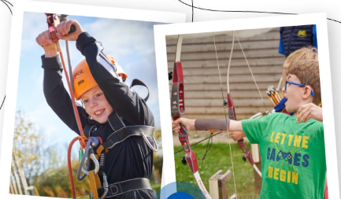
Each activity supports pupils in developing real-world skills that enhance classroom learning, build character and strengthen relationships. Through this, children learn to embrace challenges, collaborate effectively and discover their potential—gaining confidence that extends into school life and beyond.
Through problem-solving, communication and physical challenge, pupils develop key skills aligned with our ethos of personal development and character education. During this residential, our focus is on teamwork, leadership, and building resilience alongside a strong growth mindset.

Slide 7
Routines for the morning and evening will be expected for ALL children.
We would expect them to have a shower, brush their teeth and hair, dress appropriately and be ready ON TIME every morning.
Then, after the evening activity, that they are ready for bed at 9:30pm and lights out at 10pm.

Slide 8
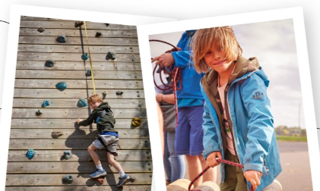
Risk Assessed Activities
All the activities meet the highest levels of safety standards. Formal risk assessments are completed at the start of each season and following any significant changes, for every centre.
All PGL's adventure activities take place under the instruction and guidance of specially trained PGL instructors who prioritise safety above all else. Activities take place on land, on the water and in the air (for our rope-based challenges), so each brings a different (and fun!) way for children to challenge themselves in a friendly, safe and supportive environment.

Slide 9
Healthy, Tasty and Nutritious Menus.
The meals provided at PGL offer a wide range of tasty and nutritious dishes which are attractive to children’s palates. To assist your children in selecting a balanced meal they serve generous portions of fruit, vegetables and salad with plenty of carbohydrate for energy.
There is also a mix of freshly-prepared hot or cold meals at various mealtimes throughout the week, as well and a self-service salad bar for children to help themselves to as much salad as they like at lunch and dinner. There is always plenty of bread and fresh fruit available, as well as hot and cold drinks.
FORMS WILL BE SENT OUT FOR YOU TO COMPLETE REGARDING ANY DIETARY REQUIREMENTS.
THESE MUST BE RETURNED TO US ASAP.

Slide 10
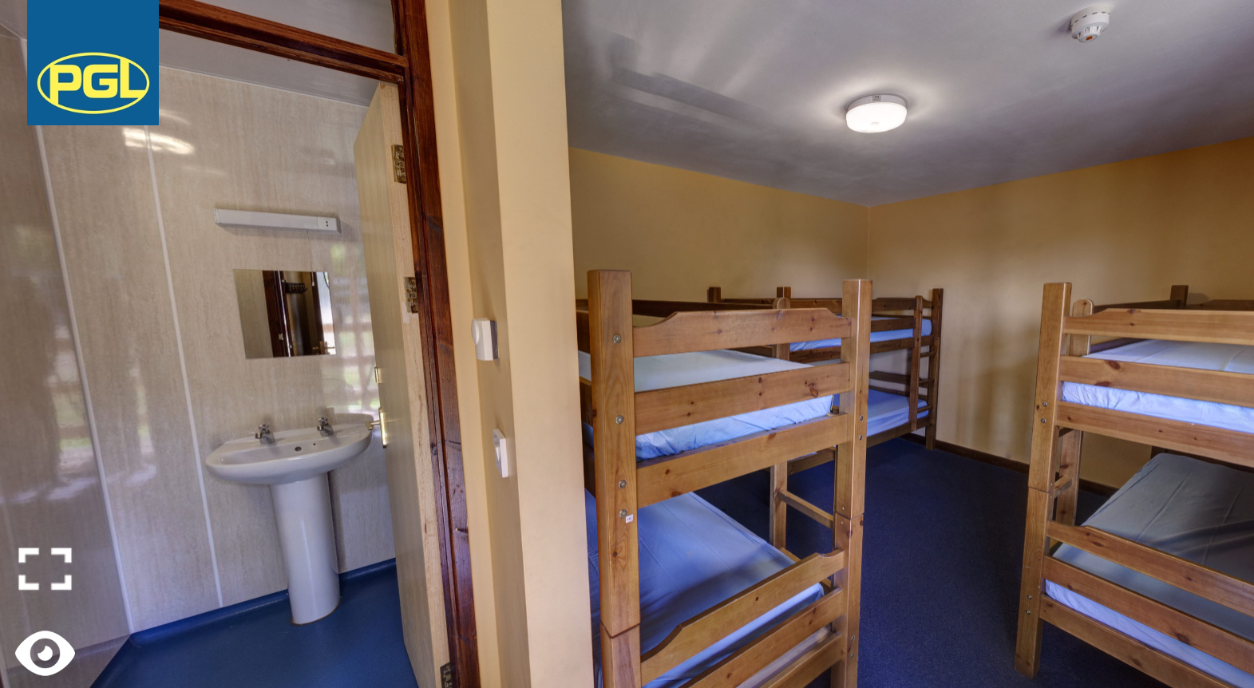
Key people
Choose three notable people of Asian Pacific American heritage using Bing.com and discuss their lives and accomplishments. Here are some examples:
Anna May Wong was the first Chinese American Hollywood movie star, as well as the first Chinese American actress to gain international recognition. She appeared in over sixty movies throughout her career.
Sessue Hayakawa was a Japanese actor and one of the biggest stars in Hollywood during the silent film era. His fame matched that of Charlie Chaplin.
Duke Kahanamoku was a Hawaiian competitive swimmer. He won five Olympic metals for swimming. He also popularized the Hawaiian sport of surfing in the US.

Slide 11
Accommodation
Accommodation is in wooden , forest style lodges which have 6 bunk beds in each lodge.
They have an en-suite bathroom, with shower, sink and a separate toilet and are set around a communal courtyard.
The staff accommodation is also set within these with easy access should the children need any support (and where we can keep an easy eye on them!).

Slide 12
PGL Staff Enhanced Check
FOR YOUR PEACE OF MIND.
For all staff working at PGL sites, the Disclosure and Barring Service* (DBS) ‘Barred List’ is checked and an ‘Enhanced’ check is applied for.
Non UK residents are subject to the equivalent checks in their home country.
All the instructors are carefully selected, highly trained and meet the requirements laid down by national governing bodies, including The Adventure Activities Licensing Authority (AALA), The British Activity Providers Association (BAPA) and the Council for Learning Outside the Classroom (LOtC).

Slide 13
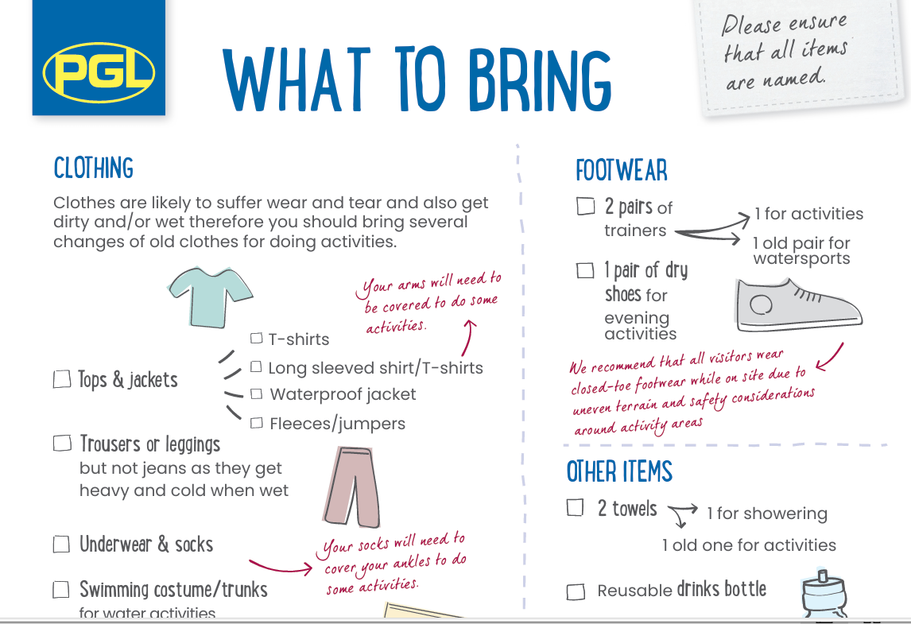
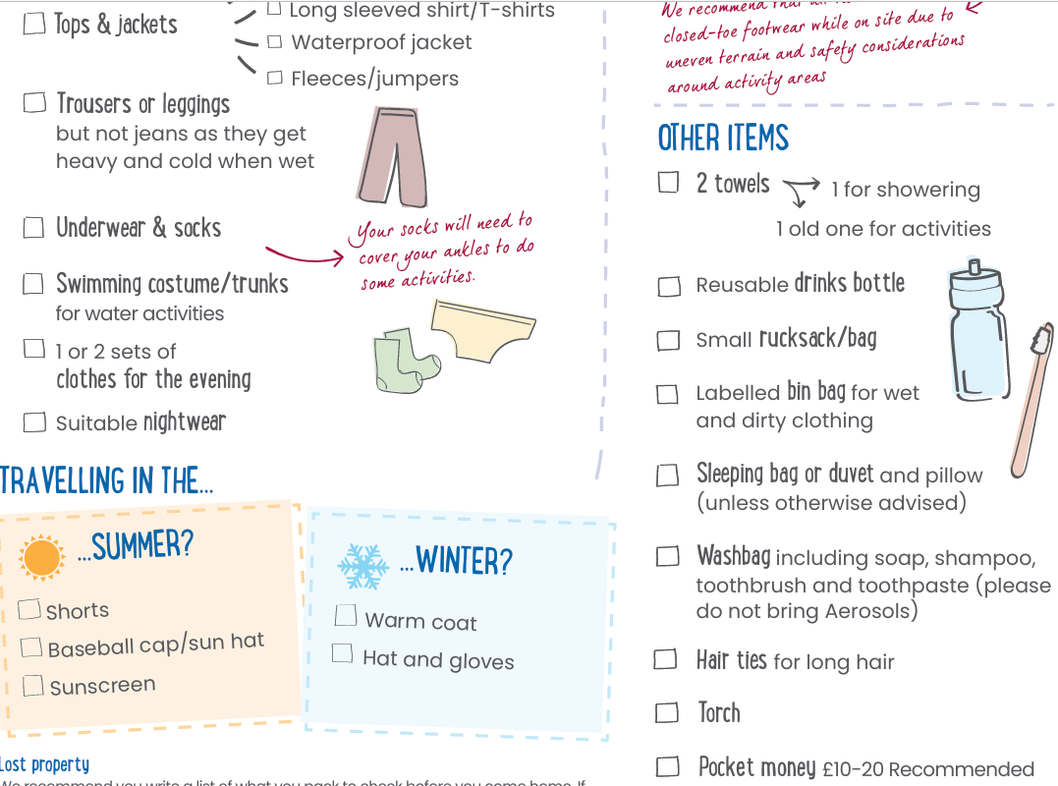
What should I pack?

Slide 14
It is sometimes helpful (for children who find organising themselves a bit more challenging) to label up their clothing for the day in separate plastic bags, according to the itinerary of the day.

Slide 15
Essential Bedding.
Please put the pillow in a black bin liner and the sleeping bag in another.
These MUST be labelled please and bungee cords work well to secure these together, which will be easier for the children once we get there.
Packing a few other bin liners will allow the children to put any used, dirty clothing in a separate place, so that their clean clothes stay clean!

Slide 16
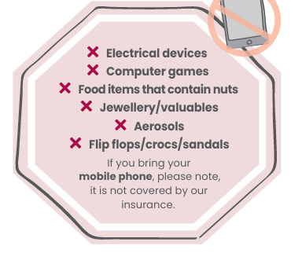
What NOT to pack!!!

Slide 17
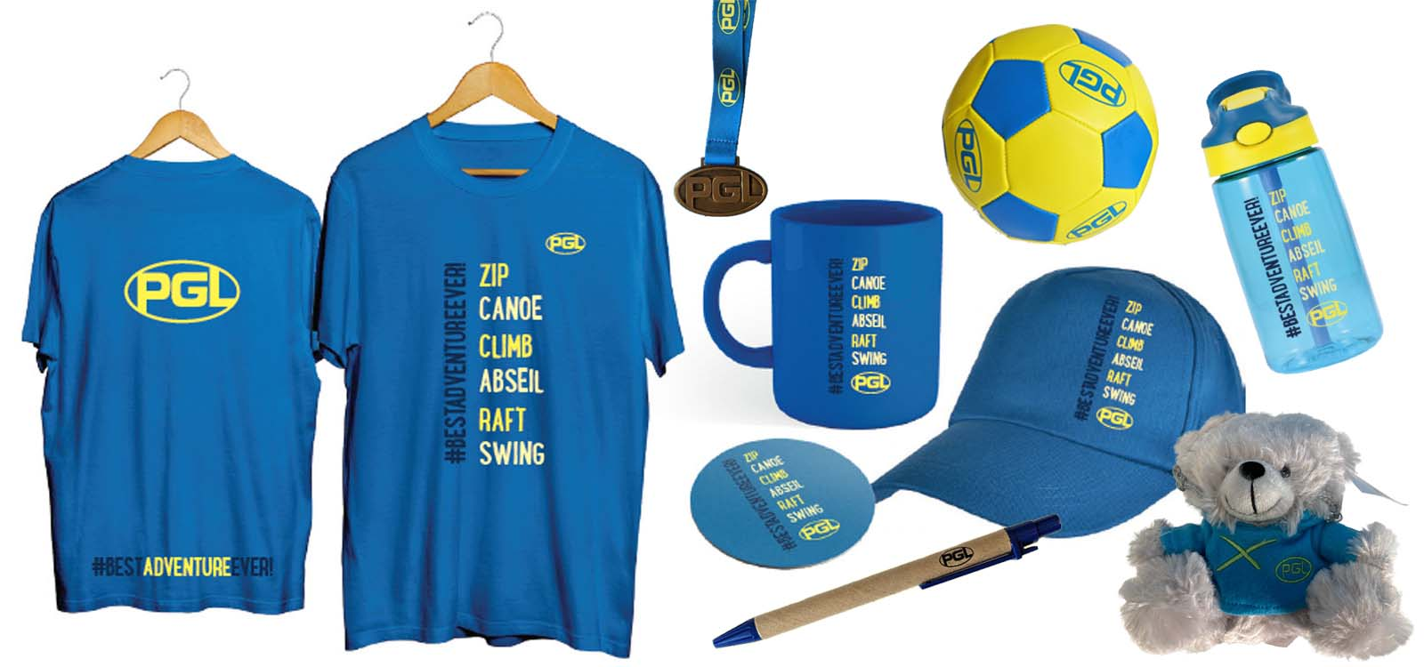
Bursting with unique goodies of all shapes and sizes, the shelves at the Gift Shop are overflowing with a selection of PGL branded souvenirs, clothing, fun gifts.
From the famous PGL teddy bears (a gift for a sibling perhaps?) to hats, bottles, keyrings, and colourful stationery – there’s something to suit all tastes and budgets. Your children can browse the shelves with their friends and select a special keepsake to remember their big adventure by.

Slide 18
IMPORTANT INFORMATION
Kit list for packing is on a separate sheet for your convenience. Please check this when sorting what to bring.
IMPORTANT : Only water should be drunk for the whole trip, this MUST be in a named water bottle with a SPORTS TOP.
Children can bring a maximum of £20 (which must be handed to their teacher in a purse/sealed plastic bag if possible). This should be in smaller notes if possible.
This can ONLY be spent on souvenirs of the trip and MUST NOT be spent on sweets or fizzy drinks.
Some sweets can be brought on the trip, but these should be kept to a minimum please. No crisps or chocolate as these create a mess in the rooms.

Slide 19
Arrangements for the days of departure and arrival.
Kemsing parents should drop their children off at normal school time and bring them to the Nest in the Phoenix block to store their luggage and bedding until the coach arrives at lunch.
Sundridge families – please could you drop any siblings off at S&B and take your Year 6 child to Kemsing after this (as the coach is only doing one pick-up and drop-off). Thank you!
Someone will be at the top of the Kemsing driveway to meet you and store your bags.
Please do not park in the doctor’s car park.
On our return on Monday afternoon, the coach will drop all the children off at Kemsing ONLY at about 2:45pm. This should allow families time to collect their children (whom they will have missed very much!) and then collect any siblings.
We will keep all families informed of our ETA via email/Class WhatsApp and Dojo should there be any changes to this time. We hope you all enjoy a quiet weekend! However, the children are not expected at school the following day – it is a day of rest and recuperation for all!

Slide 20
Thank you for listening…any questions?

