Slide 1

Transition Meeting
Reception Class
2025-2026

Slide 2
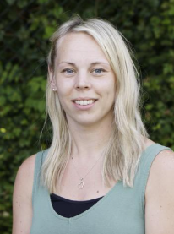
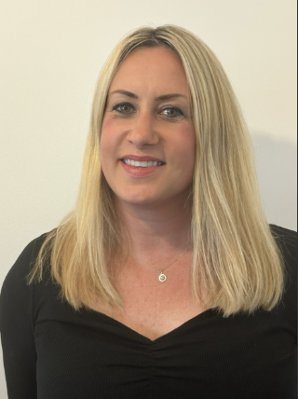
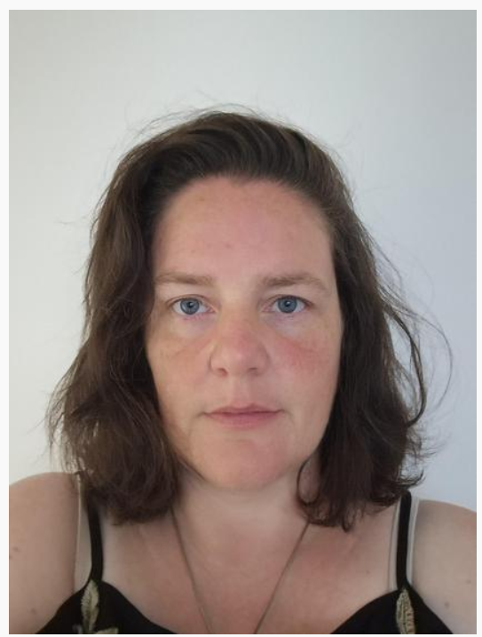
Welcome to Kemsing Primary School!
Meet the Reception Class team…
Mrs Jackaman
Class teacher
Monday- Wednesday
Mrs Kemp
Class teacher
Wednesday- Friday
Mrs M-K
Teaching assistant
Monday- Thursday

Slide 3
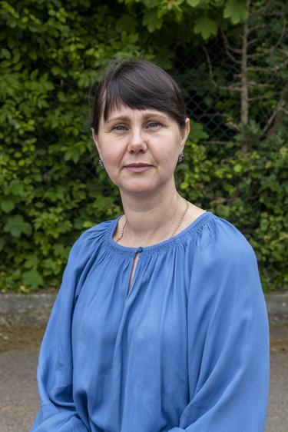
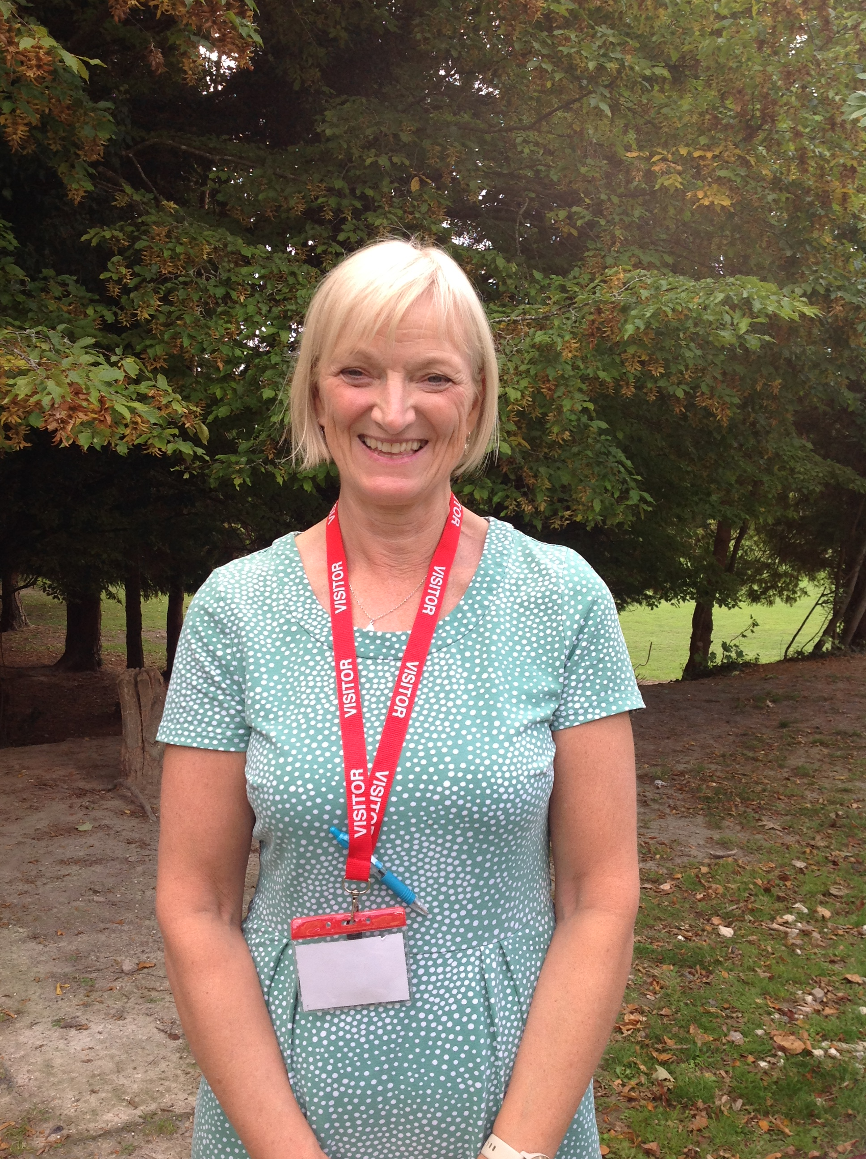
Mrs Zuyeva
Teaching assistant
Friday
Mrs Hands
Volunteer
Tuesday and Thursday afternoons
Mrs M-K
Teaching assistant
Monday- Thursday

Slide 4
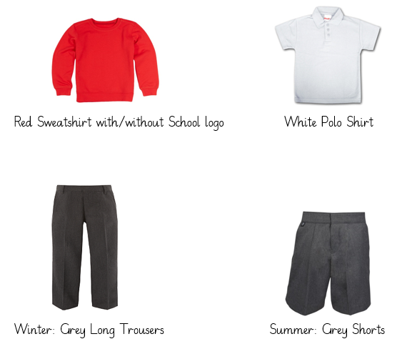
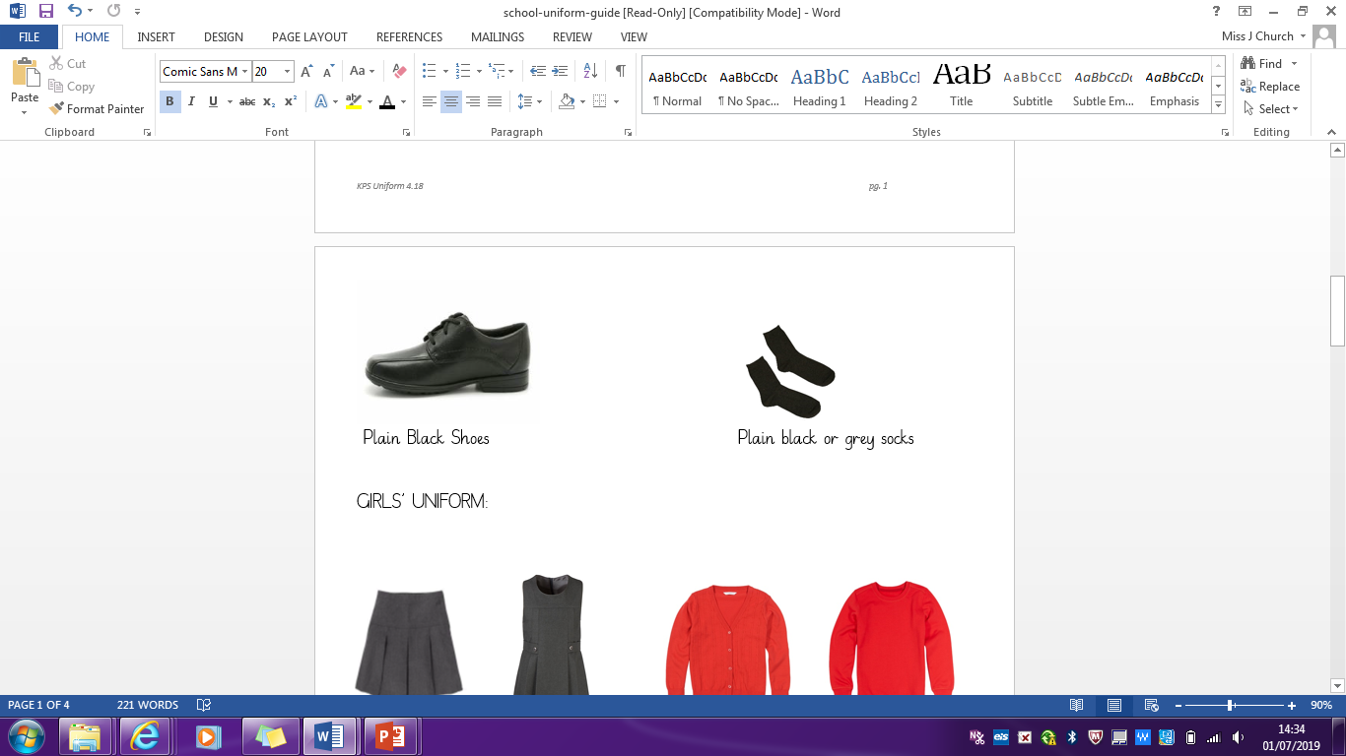
Boys Uniform
Clearly labelled
The school colours are red and grey and items such as cardigans and sweatshirts can be ordered online with our school logo. See school website.

Slide 5
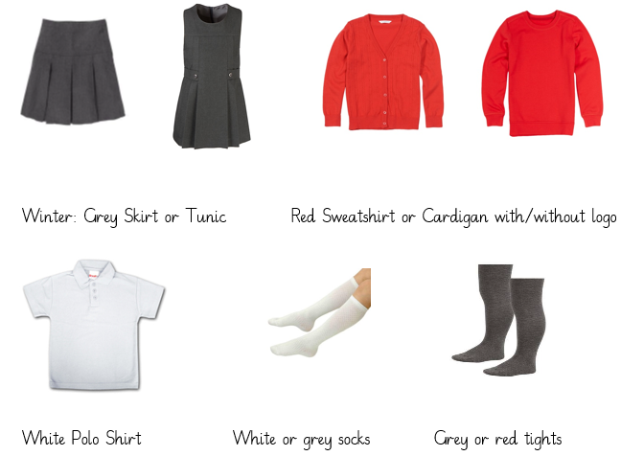
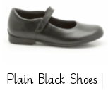
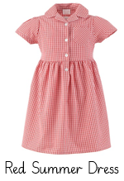
Girls Uniform
Clearly labelled

Slide 6
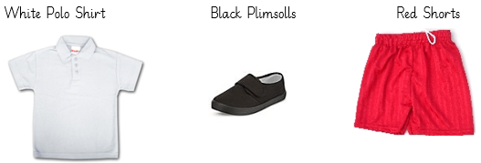
PE Kit
Please provide your child with a labelled water bottle everyday. These can be refilled during the day.
Children with their ears pierced must wear simple small studs at all times. These must be removed on PE days- we are not permitted to tape over piercings.
Coats must be brought in every day in case of changing weather.
Make sure all items including coats are named.
All long hair should be tied back away from the face with red, white or black simple hair bands.

Slide 7
General Information
The children will need a red book bag, no rucksacks please as they take up too much room on our pegs. The children can attach one small keyring to their book bag, so it is recognisable to them.
We will be going on regular welly walks and using the outdoor area in all weathers, so please supply your child with labelled wellies and a waterproof jacket that can stay in school if possible.

Slide 8
Each child will choose a story book from class to share with you at home, which will be changed every Monday. Please read with your child every day and record this in their reading record book.
When the children begin their phonics lessons and have learnt some letter sounds, they will be given a book from our reading scheme in addition to the picture book.
These books will be closely matched to your child’s reading ability and so they should read this book to you at least 3 times throughout the week. These will also be changed every Monday.
Notes:
I cannot emphasise the importance of reading with your child everyday. Please can we ask that both the scheme book and the book your child chooses from our book corner in the classroom is returned each week on a Monday.
Im now going to move onto talking about why we encourage you to read the scheme book three times over the week your child has it.

Slide 9
Your first read with your child should involve the decoding of the words. If capable of decoding the sounds in the word, encourage your child to segment then blend sounds together to read the word fully.
2. Your second read should be about focusing on the comprehension side of things.
Ask questions that will prompt your child to reveal their understanding of what it is they have read. The 5 W's of comprehension questions are particularly useful here: who, what, where, when, and why.
3. Your third+ read with your child should be to encourage confidence and fluency.
Notes:
Decoding is the ability to apply knowledge of letter-sound relationships, including knowledge of letter patterns, to correctly pronounce written words.
Segmenting is the ability to blend those sounds together and read the word as a whole.

Slide 10
Medical Information
It is very important that you have made the school aware of any allergies and medical needs your child may have. All medicines, inhalers, EpiPens etc. must be handed in at the School Office, together with a completed Care plan.
Only prescribed medicines may be brought into school.
Please make sure you notify the school of any changes in contact details in case we need to speak to you in an emergency.
Notes:
I will be asking for information regarding your child's play interests at home, any additional needs you may think they have or any allergies etc.
Please read this poem to your child and encourage your child to choose where outside the front door they would like the balloon to go. The idea of this is to help ease the anxiety of knowing that two ladies who they don’t even know are turning up outside their front door.
We will also have other bits and pieces to give to yourselves on the home visit that will hopefully help make the settling in process to Reception a lot more smoother and easier for both you and your child.
Again, we want to make the process of settling in as smooth as possible.

Slide 11
Important Dates
Stay and play sessions
Monday 7th July 9-10am
Monday 14th July 9-10am
Please bring you child to the steps on the playgroup that lead to our classroom, where a member of the Year R team will be there to greet you.
Adults will be encouraged to drop their child at the classroom door and make their way to the school hall. Refreshments will be available.
Notes:
I will be asking for information regarding your child's play interests at home, any additional needs you may think they have or any allergies etc.
Please read this poem to your child and encourage your child to choose where outside the front door they would like the balloon to go. The idea of this is to help ease the anxiety of knowing that two ladies who they don’t even know are turning up outside their front door.
We will also have other bits and pieces to give to yourselves on the home visit that will hopefully help make the settling in process to Reception a lot more smoother and easier for both you and your child.
Again, we want to make the process of settling in as smooth as possible.

Slide 12
Important Dates
Home Visits
Wednesday 3rd – Friday 5th September
Part time days
Monday 8th - Friday 12th September
Each child will be allocated either a morning or afternoon session for the week.
Morning session is 9:00-11:30am and the afternoon session is 12:30-3:00pm.
Whilst the children are in school part time, we ask that you please drop them off and pick them up using our side gate via the alley, which leads directly into our outdoor area.
Notes:
I will be asking for information regarding your child's play interests at home, any additional needs you may think they have or any allergies etc.
Please read this poem to your child and encourage your child to choose where outside the front door they would like the balloon to go. The idea of this is to help ease the anxiety of knowing that two ladies who they don’t even know are turning up outside their front door.
We will also have other bits and pieces to give to yourselves on the home visit that will hopefully help make the settling in process to Reception a lot more smoother and easier for both you and your child.
Again, we want to make the process of settling in as smooth as possible.

Slide 13
Important Dates
Part time days
During the part time sessions, the children will be taken on a tour of the school and introduced to members of staff. They will also have a chance to explore the classroom, playtime areas, meet each other and begin to learn the rules and routines within the school day.
The children have been split into a morning and afternoon group as this gives them a chance to familiarise themselves with the school environment and gives the staff a chance to get to know each child in a smaller group.
Notes:
I will be asking for information regarding your child's play interests at home, any additional needs you may think they have or any allergies etc.
Please read this poem to your child and encourage your child to choose where outside the front door they would like the balloon to go. The idea of this is to help ease the anxiety of knowing that two ladies who they don’t even know are turning up outside their front door.
We will also have other bits and pieces to give to yourselves on the home visit that will hopefully help make the settling in process to Reception a lot more smoother and easier for both you and your child.
Again, we want to make the process of settling in as smooth as possible.

Slide 14
Important Dates
Morning only and staying for lunch for all children
Monday 15th – Friday 19th September
Children can arrive from 8.35am (doors close at 8.50am)
Please bring you child to the steps on the playgroup that lead to our classroom, where a member of the Year R team will be there to greet you.
All children will stay for lunch and be collected at 1pm. Please use the side gate via the alley, which leads directly into our outdoor area.
Full time
Monday 22nd September
Notes:
I will be asking for information regarding your child's play interests at home, any additional needs you may think they have or any allergies etc.
Please read this poem to your child and encourage your child to choose where outside the front door they would like the balloon to go. The idea of this is to help ease the anxiety of knowing that two ladies who they don’t even know are turning up outside their front door.
We will also have other bits and pieces to give to yourselves on the home visit that will hopefully help make the settling in process to Reception a lot more smoother and easier for both you and your child.
Again, we want to make the process of settling in as smooth as possible.

Slide 15
Collection Arrangements
Parents must inform the class teacher if they require any one apart from themselves to collect their child.
Please notify and ideally introduce them to the class teacher. For the safety of your child, we will not allow anyone else to collect your child unless we have your permission.
Notes:
I will be asking for information regarding your child's play interests at home, any additional needs you may think they have or any allergies etc.
Please read this poem to your child and encourage your child to choose where outside the front door they would like the balloon to go. The idea of this is to help ease the anxiety of knowing that two ladies who they don’t even know are turning up outside their front door.
We will also have other bits and pieces to give to yourselves on the home visit that will hopefully help make the settling in process to Reception a lot more smoother and easier for both you and your child.
Again, we want to make the process of settling in as smooth as possible.

Slide 16
Lateness and Attendance
Children must attend school every day. If a child is unwell, keep them at home and phone the office to let the school know.
Children must be at school no later than 8.50am. Bringing your child in late will result in them missing the most important part of the day where the main teaching takes place.
Children must be collected from school on time. Teachers often have meetings to attend after school and lateness can be very disruptive. It can also be distressing for your child if you are late to collect them.
Notes:
I will be asking for information regarding your child's play interests at home, any additional needs you may think they have or any allergies etc.
Please read this poem to your child and encourage your child to choose where outside the front door they would like the balloon to go. The idea of this is to help ease the anxiety of knowing that two ladies who they don’t even know are turning up outside their front door.
We will also have other bits and pieces to give to yourselves on the home visit that will hopefully help make the settling in process to Reception a lot more smoother and easier for both you and your child.
Again, we want to make the process of settling in as smooth as possible.

Slide 17
School Meals
An email will be sent during the first week of September from Parent Pay. This will include login details to set up your online account.
Once registered, you can view menus and order school meals.
School meals are free for all children in Reception and KS1.
If you would prefer, children can bring a packed lunch from home. This should contain healthy foods and NO NUTS please, as we are a nut free school.
Notes:
Please can I ask parents that when it comes to your child lining up in the playground ready to come into class that they do not run around. We have had little toddlers/siblings wandering around the playground this year and reception children running around then bumping into them, resulting in some not so nice head injuries.

Slide 18
Year 6 Buddies
Each child will be paired with a Year 6 Buddy. Their buddy will sit with them at lunch time, helping them with cutting up their food if needed. The buddies will also help the children when moving around the school and initiating play during break times.
We base the buddy pairings on what we know about each child and how well they will get on. The Year 6 children look forward to this and put lots of effort into spending time with their buddies. We also arrange play sessions with both classes throughout the year for the children to get to know each other.
Notes:
During the course of the school year, I will look to ask the year six buddies to slowly and gradually separate from their reception buddy. This allows your reception child to gradually become more responsible for themselves and care for their own needs which will be required more from them once going into year one.
I will also be looking to set up a reading session once a week for your child with their year six buddy. This is a fantastic opportunity to develop your child's love, passion and interest to read. Furthermore, it opens up more times for your child to be immersed in new vocabulary, gradually developing your child's comprehension skills. Also, developing your child's understanding of the different types of genres of books and the many different purposes a book can be used for.

Slide 19
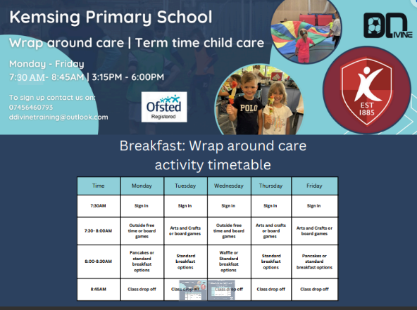
Wraparound Care
Notes:
During the course of the school year, I will look to ask the year six buddies to slowly and gradually separate from their reception buddy. This allows your reception child to gradually become more responsible for themselves and care for their own needs which will be required more from them once going into year one.
I will also be looking to set up a reading session once a week for your child with their year six buddy. This is a fantastic opportunity to develop your child's love, passion and interest to read. Furthermore, it opens up more times for your child to be immersed in new vocabulary, gradually developing your child's comprehension skills. Also, developing your child's understanding of the different types of genres of books and the many different purposes a book can be used for.

Slide 20
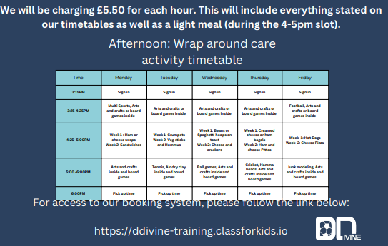
Wraparound Care
Notes:
During the course of the school year, I will look to ask the year six buddies to slowly and gradually separate from their reception buddy. This allows your reception child to gradually become more responsible for themselves and care for their own needs which will be required more from them once going into year one.
I will also be looking to set up a reading session once a week for your child with their year six buddy. This is a fantastic opportunity to develop your child's love, passion and interest to read. Furthermore, it opens up more times for your child to be immersed in new vocabulary, gradually developing your child's comprehension skills. Also, developing your child's understanding of the different types of genres of books and the many different purposes a book can be used for.

Slide 21
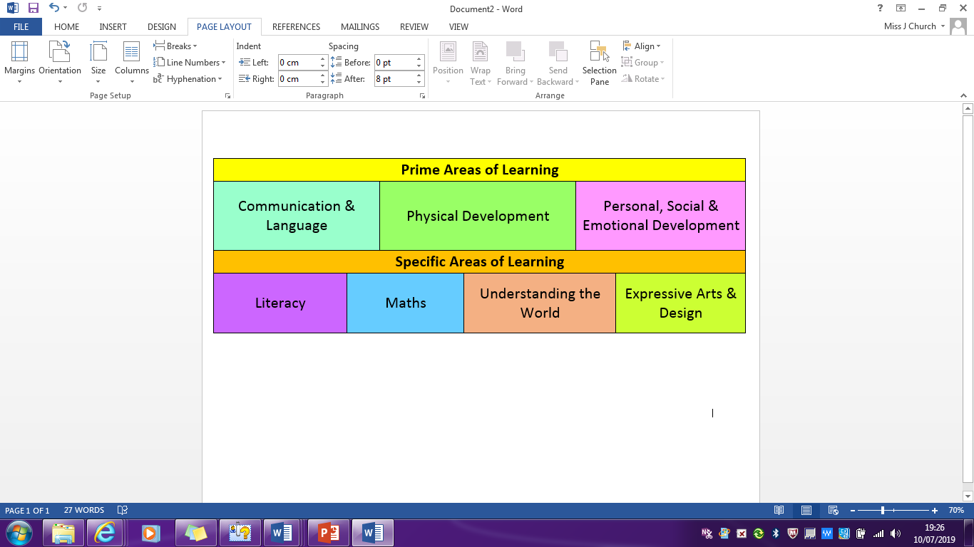
Early Years Framework
Teacher directed: a learning activity led by the teacher.
Child Initiated: the children choose where to play and what with. Adults take this opportunity to interact with the children and enhance their play.
Notes:
The prime areas of learning are the ones which your child needs to develop effectively in should they be able to access and develop in the specific areas as seen underneath. If your child attended nursery or a pre-school they would usually be focusing upon the prime areas and developing your child in these so they are ready to start developing in the specific.
As reception teacher, I don’t stop teaching in the three prime areas. Everyday, an activity or circle time will be set up that will encourage one of these areas for development. For example, on our outdoor learning trips to the field we will be developing all three of them at once. I may also do circle times that explores the different emotions and feelings, using puppets to role model different scenarios out to show the children how actions can have an effect on others feelings.
The specific areas such as Literacy and math's will be visited everyday in their phonics and math's lessons. The other two areas will be explored through your child's play with activities that have been set up specifically that help consolidate and strengthen new learning your child has engaged in.
After your child has engaged within a maths lesson, I will be sending the children group at a time with the TA to engage in an activity pre-set up that will help develop and consolidate your child's learning that they would have just had with me. My TA will then feedback to me how the majority of the children got on and this aids in my planning of the next lesson should I need to revisit this learning or moving on to the next stage!

Slide 22
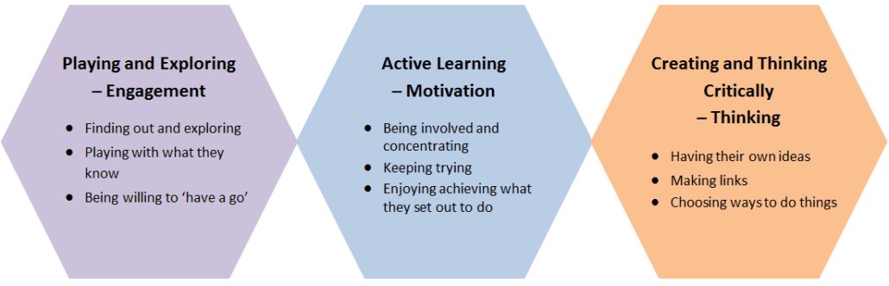
Characteristics of Effective Learning
These characteristics are not separate but rather work together to create a holistic approach to learning. They are the foundation for developing a lifelong love of learning and a positive attitude towards challenges and new experiences.
Notes:
During each lesson I teach I will also be looking to develop these characteristics of effective learning with your child. These characteristics aim to help develop your child to have a love for learning and to become a learner for life.
For example, the second characteristic, active learning focuses on developing a child's self-regulatory skills, basically their attitudes towards learning and the ability to never give up should a task become too challenging. I like to use marvelous mistakes within my teaching. Should a child get something wrong on the carpet, with my children currently we will clap that child and praise them for getting it wrong. I will then ask questions that allow me to see where the child went wrong and model how to come to that answer correctly.
In this whole process, I am teaching children that failure is not a bad thing but a good thing, that it is how we learn more. I am also teaching them how to correct their mistakes, if you like showing them strategies to help with getting the answer correct for the next time.
In my classroom next year, I will have a board known as the marvellous mistakes board and every child who gets something wrong will have their name put up with the mistake underneath it. Again, my aim is to develop a classroom environment that feels safe. It is proven that children learn more effectively when they feel safe.

Slide 23
Seesaw
Seesaw is a platform for student engagement. We use Seesaw as an informal log of any ‘wow’ moments that we capture in a photograph or video. You also have the option to comment and share any progress from home. You can upload notes, photographs or videos for Reception staff and children to see.
You will each be given a login code for your child in September.
Notes:
As much as possible, I encourage parents to share with me how their child is getting on at home, for example, through the use of the reading record book. It allows both myself and my TA to know whether your child needs more support or is ready to move on in their learning.
Each term, I believe, we have what's called celebration of learning. This is a chance for you to all come and see what it is your child has been learning over the term with myself. Again, developing that relationship between home and school. It is also a chance for your child/children to share any work they are proud of over the term with yourselves.

Slide 24
Newsletters
Each Monday you will receive a weekly newsletter with news about the coming week and an idea on what the children have been focusing on in their phonics, maths or topic lessons. This will be sent onto our seesaw platform or via email from the school office.
The newsletter will also include any reminders for the week such as cake sales, non-uniform days etc.

Slide 25
Show and Tell Treasure box
It can be a little overwhelming for young children to start a new school year, so why not send a little bit of comfort with them to school to show and tell their new friends and teacher?
They can put anything they want inside their boxes (a small shoe box works perfectly) to come and share with the class during the first week.
This can be their favourite toy, photos, favourite storybook, art they have made during the holidays, or even holiday souvenirs.
The teachers are busy making their own show and tell treasure boxes, which we hope to share with the children during the stay and play sessions.

Slide 26
Thank you for listening ☺
Any questions?

