Slide 1
Welcome to Year 6
Teachers: Mrs T. Burton
Mrs G. Watson
Teaching Assistant: Miss J. Scott

Slide 2
A bit about us…
Mrs Burton and Mrs Watson - Teachers
Miss Scott - Teaching Assistant
Our Year 6 Kemsing School Class Reps are: Mrs Saville and Mrs Rogers – thank you, ladies!

Slide 3
Routines
8:30am As coming into school is now a trickle entry, children can come in from 8:30am and the doors close at 8:45am. EMW begins at 8.35am
The earlier the better!
Water Sports top please and will be kept on desks.
Children need water constantly to perform at their best – as we all do!
Book bags Reading Record and Pupil Planner MUST BE brought in every morning and taken home every evening. Parents are expected to sign their planner once a week please.
Smart watches No communication during the school day please.
Not allowed in 11+ or SATs.
All home reading must be logged in the Reading Record daily. It can be a book of their choice or their school reading book. Reading is essential at least 4 times per week

Slide 4
Curriculum (all on website)
ENGLISH
Once by Morris Gleitzman, The Arrival by Shaun Tan, The Promise by Nicola Davies, Suffragettes by David Roberts and MATHS
Place value, addition, subtraction, multiplication and division, Fractions, percentages, decimals, shape and geometry and converting units are some of the units we cover.
HISTORY
The Census including Local history. Who Should Feature on the £10 Banknote? After the WWII what was the impact of people in Britain?
SCIENCE
Classification, Adaptation, Inheritance and Evolution, Light and Reflection, Electricity, Circulation and Health

Slide 5
Curriculum
DT
Come Dine With Me
Electrical systems
Needlecraft
COMPUTING
Online Safety
Communication and Collaboration
Webpage creation
Variables in games
Introduction to Spreadsheets
MUSIC
Following Kapow SoW
FRENCH
Sport and the Olympics
French cafes and around town
My French house
Planning a French holiday

Slide 6
Homework
99 Club for times tables where needed.
Daily reading – this is the key to everything!
One piece of homework a week which should be recorded in their homework books. This will be linked to learning during the week, either as pre-learning or post-learning.
Homework Club will be available on a Friday lunchtime as when needed with Mrs Watson.
Homework and Spellings are set on Monday and expected in on the following Monday. Please, where possible, oversee your child/children’s work. Thank you.
Reading at home is SO important – even 15 mins a night would make a difference!
Please note any home reading in the Reading Record. ANY type of reading!
Readers / Helpers

Slide 7


Slide 8
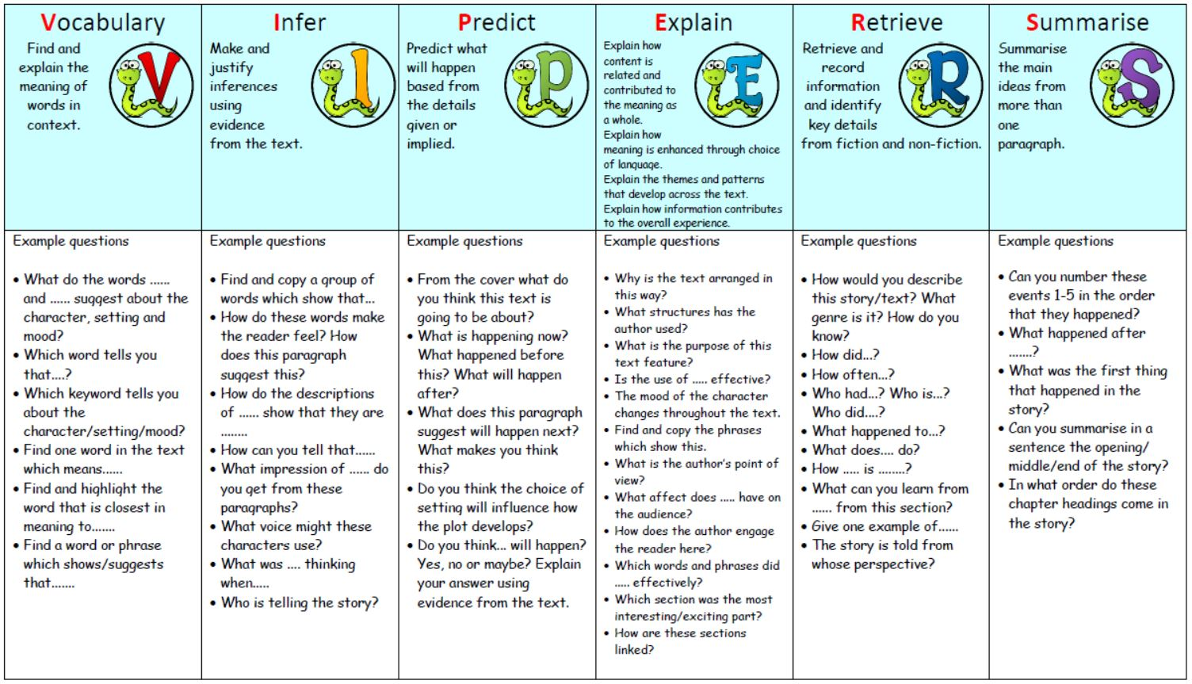

Slide 9
Additional Year 6 Information
SATs – these are the statutory exams which your child will be taking in May 2026. They include Reading Comprehension, Mathematics and Grammar, Punctuation and Spelling. A separate assessment of their writing also takes place, but this is across the whole year. More information on this will be sent out nearer the time.
ISEB tests – Atom Learning – please speak to me separately about this should you wish to have further information.
Residential Trip – PGL Windmill Hill. 15th May to 18th May 2026
This will be a wonderful opportunity for your child/children to take part in an activity adventure extended weekend. A deposit of £40 should be paid by 26th September 2025. Cost will be around £278, payable at £40 per month to the school office.
SEPARATE INFORMATION WILL BE AVAILABLE NEXT YEAR.

Slide 10
Extra Info...!
PE is on Thursdays and Fridays.
Come to school in PE kits, please.
Earrings need to be removed or covered with tape if they have just been pierced.
Watches should be removed.
Long hair should always be tied up for boys and girls.
Every item of clothing must be labelled.
BIKEABLITY – we hope your children benefitted from these sessions!

Slide 11
Safeguarding on Mobile devices
Children are more inclined than ever these days to have their own devices which allows them access to the Internet. As such it can become difficult to monitor the amount of time they are online.
Problems at school are often related to online content and communication, therefore we would ask that adults regularly check their children’s phones and devices for signs of unwanted behaviour including bullying.
Children of primary age should not be using the likes of Facebook, WhatsApp or Instagram. Safety, privacy and wellbeing settings should be on all devices, as well as all passwords should be known to the parents or carers.
Please have agreed rules and boundaries for use and regular safety conversations. We shall also be having these with your children.

Slide 12
Finally…
All children should feel safe and happy at school so if you have any concerns, we are always happy to help.
Our mornings are usually spent preparing for the day ahead so please speak to us at the end of a school day, if possible. However, if it is urgent for that day, then please come and speak to us.
To arrange an appointment, please contact the office or put a note in the Pupil Planner. We have an open door policy, so please do not hesitate to get in touch with any of us in the first instance.

Slide 13
Thank you for your time and for coming to meet us!
Any questions?

