Slide 1

Welcome to Year 5
Teacher: Mrs K. Jones
Teaching Assistant: Mrs J. Falcon-Uff

Slide 2
A bit about us…
Mrs Jones
Mrs Falcon-Uff - Teaching Assistant

Slide 3
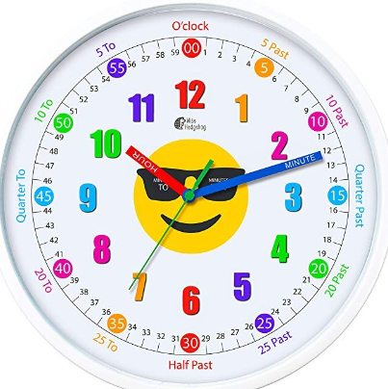

Routines
8:35am Coming into school is a trickle entry, children can come in from 8:35am and the doors close at 8:45am. The earlier the better!
Water Sports top bottles please. Water bottles are kept in the water bottle area. The children have access to this throughout the day.
Book Bags Reading Record and Pupil Planner must be brought in every morning and taken home every evening.
Parents are expected to sign the planners once a week please.
All home reading must be logged in the Reading Record daily.
It can be a book of their choice or their school reading book.

Slide 4


Curriculum Autumn Term 1
ENGLISH
Our Reading and Writing texts for Term 1.

Slide 5
Curriculum Autumn Term 1
MATHS
Place value and addition and subtraction.
HISTORY
Comparing Henry VIII and Elizabeth I, children learn about the changing nature of monarchy. They examine how monarchs tried to control their public images using portraits and royal progresses. Using Tudor inventories to investigate whether people were rich or poor, children learn what life was like for people in Tudor times.
Later in the term, we will visit Knole House and Park to take part in Tudor workshops including music and dance, costumes and artefact handling.
SCIENCE
The children will explore the Earth, Moon, Sun and solar system. They will use the idea of the Earth’s rotation to explain day and night and the apparent movement of the sun across the sky. Describe the movement of the Moon, relative to the Earth, and describe the Sun, Earth and Moon as approximately spherical bodies.

Slide 6
Curriculum Autumn Term 1
ART
Throughout our Art lessons this term the children will work towards producing a retro-futurism inspired mixed media piece of a view in Space.
PSHE/COMPUTING
Our focus for this term is online safety. The children will consider how to use technology safely, respectfully, and responsibly. They will develop an understanding of acceptable/unacceptable behaviour and identify a range of ways to report concerns about content and contact.
MUSIC
The children will be learning to play the recorder, whilst learning to read and write some notes.
The children will learn how to hold the recorder and form the correct lip shape (embouchure) to help them to make a good, consistent sound. They will also start to explore how to control breathing and tonguing to sound notes.

Slide 7
Homework
Times Table Rock Stars.
Daily reading.
Homework will include spelling words to learn and write into full sentences, an arithmetic activity and a short reading comprehension.
Homework will be linked to learning during the week, either as pre-learning or post-learning.
Homework and Spellings are set on a Friday and expected in on the following Thursday.
Homework Club runs on a Monday lunchtime 12-12:30pm. All children are welcome to attend.
Weekly spellings test will be on a Friday morning.
Please, where possible, oversee your child/children’s work.
Thank you for your support.
Reading at home is SO important – even 10 mins a night would make a difference!
Readers / Helpers are always very welcome.

Slide 8


Slide 9
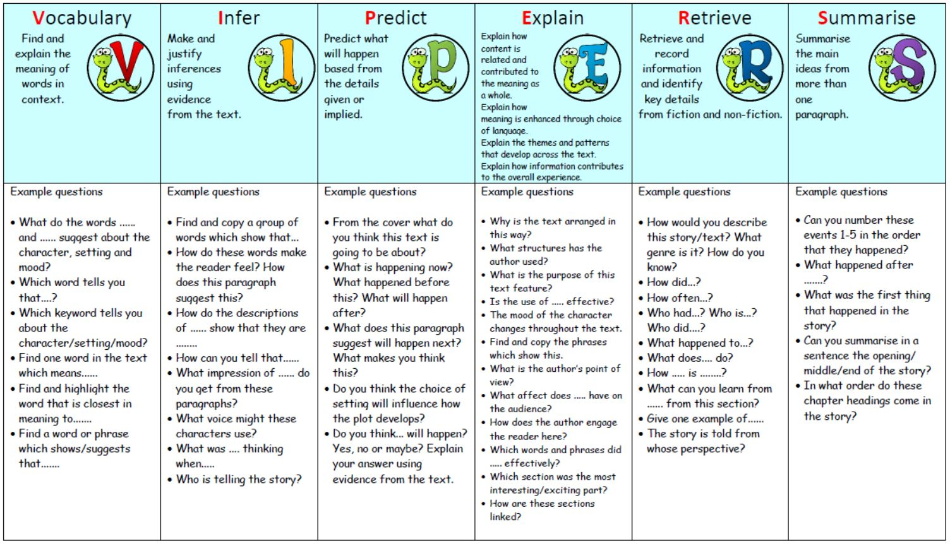

Slide 10
Extra Info...!
PE is on a Tuesday and Wednesday afternoon.
Children may come to school in their PE kits.
  Earrings need to be removed or covered with tape if they have just been pierced.
  Watches should be removed.
  Long hair should be tied up.

Slide 11
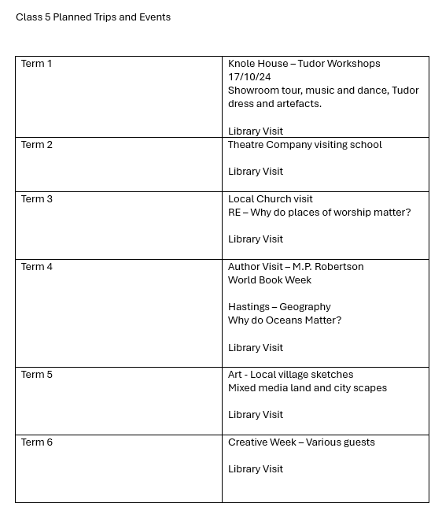

Slide 12
Finally…
All children should feel safe and happy at school so if you have any concerns, we are always happy to help.
Our mornings are usually spent preparing for the day ahead so please speak to us at the end of a school day if possible.
To arrange an appointment, please contact the office or put a note in the Pupil Planner. We have an open-door policy, so please do not hesitate to get in touch with us if we can be of any help.

Slide 13
Thank you for your time and for coming to meet us!
Any questions?

